Slide 1

ICCAT Workshop: investigation into bycatch estimation methodologies
Welcome and introductions
Module 1: Overview of BycatchEstimator R package
Facilitators:
Dr. Beth Babcock
Dr. Ana Adao

Slide 2

Introductions

Slide 3
Workshop objectives
ICCAT is supporting investigation into estimation methodologies for bycatch of non-targeted species
As part of this commitment, a statistical toolkit (R package) has been developed for semi-automated estimation of dead and live discards using model-based and design-based estimators.
During this 3-day workshop, attendees will have the opportunity to receive training on:
the use of BycatchEstimator tool from the developers,
apply estimation methodologies to their own data sets.

Slide 4
Our shared expectations
The workshop is aimed at promoting the generalized use of the BycatchEstimator R library by scientists that regular do bycatch estimation.
Data confidentiality will be strictly respected. Attendees will be expected to run the tool from their own laptops on their own data.
The goal of the workshop is to share scientific methodologies for bycatch estimation, not to produce or report bycatch estimates.
Please ask questions! The tutorials are meant to be interactive.

Slide 5
Agenda Day 1, Morning
Time | Agenda topic
Day 1
9:00 am | Welcome and introductions
9:30 am | Module 1: Overview of Bycatch Estimator R package R Tutorial 1: Overview of Bycatch Estimator
10:30 am | Break
11:00 am | Module 2A: Design-based estimators R Tutorial 2: Design-based estimators
1:00 pm | Lunch On your own.

Slide 6
Agenda Day 1, Afternoon
Time | Agenda topic
Day 1
2:30 pm | Module 2B: Model-based estimators Module 3: Diagnostics and residuals
4:00 pm | Break
4:30 pm | R Tutorial 3: Model-based estimators and diagnostics
6: 00 pm | Conclude for the day

Slide 7
Agenda Day 2, Morning
Time | Agenda topic
Day 2
9:00 am | Module 4: CPUE standardization R Tutorial 4: CPUE standardization Module 5: Data formatting R Tutorial 5: Data checking
10:30 am | Break
11:00 am | Participants sharing of challenges and needs Break-out groups, supported by workshop facilitators, applying the tool to their own data
1:00 pm | Lunch. On your own.

Slide 8
Agenda Day 2, Afternoon
Time | Agenda topic
Day 2
2:30 pm | Break-out groups, supported by workshop facilitators, applying the tool to their own data
4:00 pm | Break
4:30 pm | Continue break-out groups
6:00 | Conclude for the day

Slide 9
Agenda Day 3
Day 3
9:00 am | Continue break-out groups
10:30 am | Break
11:00 am | Continue break-out groups
1:00 pm | Lunch. On your own.
2:30 pm | Discussion share-back of modeling results & challenges. discussion of implementation challenges.
4:00 pm | Break
4:30 pm | Continue discussion
6:00 pm | Concluding remarks

Slide 10
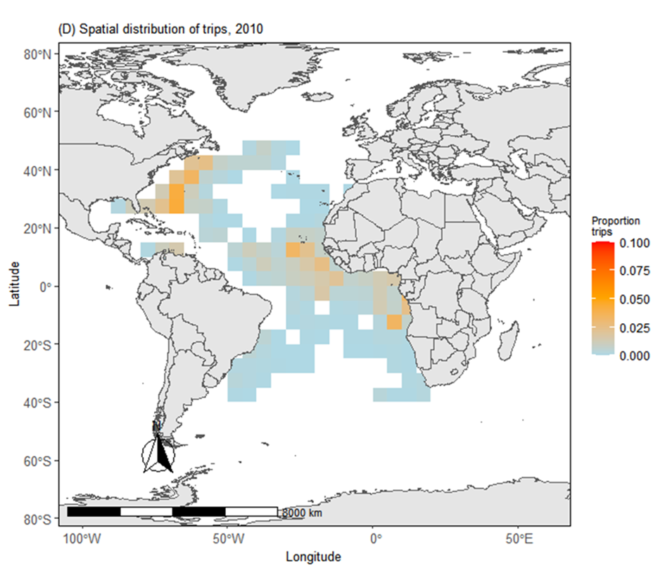
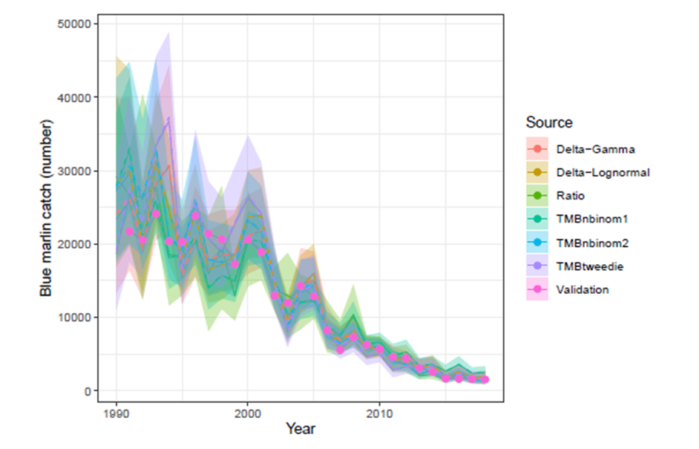
BycatchEstimator Overview
BycatchEstimator is used to estimate total annual bycatch by expanding the data from an observer program to the total effort from logbooks or landings records.
Fishing effort
Bycatch estimates

Slide 11
BycatchEstimator Overview
Uses model-based and design-based procedures to estimate total annual bycatch.
Can also be used to estimate an annual index of abundance, calculated only from the observer data.
Model-based bycatch estimation uses generalized linear models (GLM) based on the user’s choice of observation error models.
The design-based methods include a stratified ratio estimator, and the delta-lognormal estimator of Pennington (1983), and the user may specify the stratification variables for these estimators (e.g. seasons, spatial areas).

Slide 12
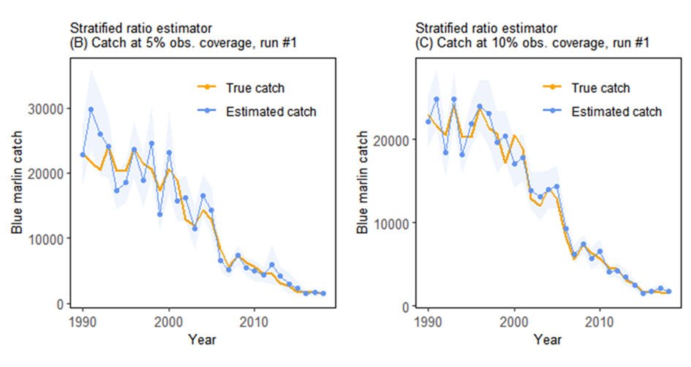
Development history
Evaluation against simulations
Evaluation against US LL data
Beta testing with diverse users
Babcock & Goodyear (2021). SCRS/2021/078
Babcock et al. (2022). SCRS/2022/105
Babcock et al. (2023). SCRS/2023/025
Notes:
To evaluate the efficacy of the bycatch estimation tool for bycatch species such as billfish (Blue Marlin, White Marlin and Round-scale Spearfish), simulation testing was carried out by coupling the longline simulator LLSIM (Goodyear 2021) with an additional simulation model that produces observer databases.
Largely focused on the question of re-capturing patterns in simulated data.

Slide 13
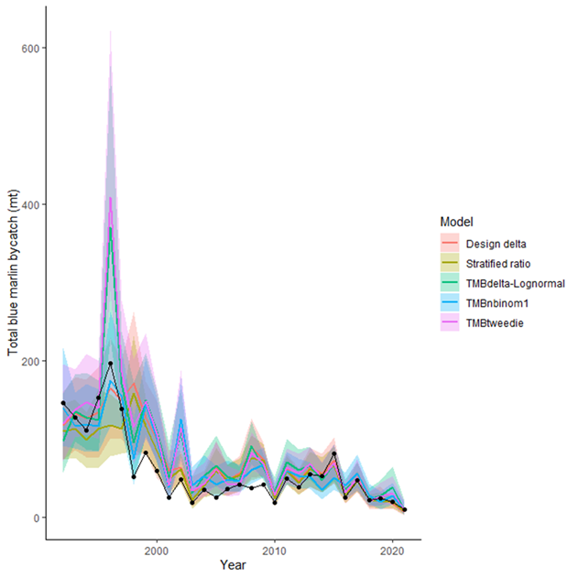
Development history
Evaluation against simulations
Evaluation against US LL data
Beta testing with diverse users
Babcock et al. (2023). SCRS/2023/025
More realistic simulations of US LL observer program, plus application to real US LL data
Notes:
USA Task 1 data are presented as the solid black line.

Slide 14
Development history
Evaluation against simulations
Evaluation against US LL data
Beta testing
2023 workshop: beta testing and feedback.
2024 workshop: Broader roll out and training

Slide 15




Resources & documentation
Box folder: Bycatch Estimator Training > Workshop Materials
Each presentation is accompanied with R Markdown file containing related code
Vignette
https://ebabcock.github.io/BycatchEstimator/index.html
Source code
https://github.com/ebabcock/BycatchEstimator
Tutorial video
https://miami.app.box.com/s/sjqwj3c1v1tcv4y3n169u3x5bs18rir2

Slide 16
Code map
Inputs
Key functions
Outputs
Observer data
bycatchSetup
Sets global conditions and makes a preliminary data summary.
Data summary
PDF
CSV
Setup file (.rds)
Design based estimates
Logbook data
Main analysis
Within-model variable selection
Residuals and diagnostics
Annual abundance indices
Annual total bycatch
Cross-validation of CPUE prediction
PDF / CSV
bycatchFit
Produces model-based estimates of bycatch and annual abundance index

Slide 17
Basic data setup
*For non-aggregated data where each row is a trip (or set)
Observer data
Logbook data
Stratification variables
To be expanded against logbook effort
Must be in same units
CPUE standardization
Optional
Matching column
Year | Area | Catch | Effort | Enviro Variable 1 | Trip ID
2010​ | 1 | 3 | 1​00 | 29.72511​ | 1
2010 | 2 | 2 | 120 | 19.97782​ | 2
2011 | 1 | 0 | 142 | 5.932128​ | 3
2011​ | 2 | 1 | 178 | 23.30121​ | 4
2012 | 1 | 5 | 201​ | 22.34505​ | 5
Trip ID | Unsampled effort | Effort | Area | Year
1 | 0 | 1​00 | 1 | 2010​
2 | 0 | 120 | 2 | 2010
3 | 0 | 142 | 1 | 2011
4 | 0 | 178 | 2 | 2011​
5 | 0 | 201​ | 1 | 2012

Slide 18
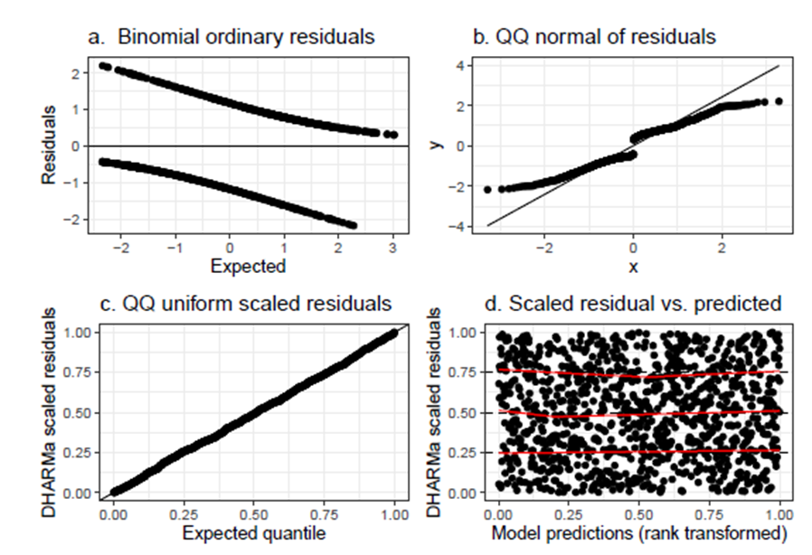
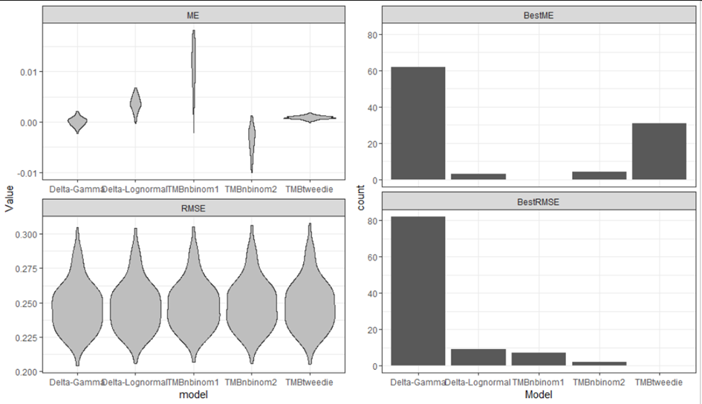
Typical outputs
Bycatch estimates
Residuals
Cross-validation

